Slide 1
Chapter 3 Data Warehousing and Analytical Processing
Data warehouse
Data warehouse modeling: schema and measures
OLAP operations
Data cube computation
Data cube computation methods

Slide 2
Chapter 3 Data Warehousing and Analytical Processing
Data warehouse
Data warehouse: what and why?
Architecture of data warehouses: enterprise data warehouses and data marts
Data lakes
Data warehouse modeling: schema and measures
OLAP operations
Data cube computation
Data cube computation methods

Slide 3
What is a Data Warehouse?
Defined in many different ways, but not rigorously
A decision support database that is maintained separately from the organization’s operational database
Support information processing by providing a solid platform of consolidated, historical data for analysis
“A data warehouse is a subject-oriented, integrated, time-variant, and nonvolatile collection of data in support of management’s decision-making process.”—W. H. Inmon
Data warehousing:
The process of constructing and using data warehouses

Slide 4
Data Warehouse—Subject-Oriented
Organized around major subjects, such as customer, product, sales
Focusing on the modeling and analysis of data for decision makers, not on daily operations or transaction processing
Provide a simple and concise view around particular subject issues by excluding data that are not useful in the decision support process

Slide 5
Data Warehouse—Integrated
Constructed by integrating multiple, heterogeneous data sources
relational databases, flat files, on-line transaction records
Data cleaning and data integration techniques are applied.
Ensure consistency in naming conventions, encoding structures, attribute measures, etc. among different data sources
Ex. Hotel price: differences on currency, tax, breakfast covered, and parking
When data is moved to the warehouse, it is converted

Slide 6
Data Warehouse—Time Variant
The time horizon for the data warehouse is significantly longer than that of operational systems
Operational database: current value data
Data warehouse data: provide information from a historical perspective (e.g., past 5-10 years)
Every key structure in the data warehouse
Contains an element of time, explicitly or implicitly
But the key of operational data may or may not contain “time element”

Slide 7
Data Warehouse—Nonvolatile
Independence
A physically separate store of data transformed from the operational environment
Static: Operational update of data does not occur in the data warehouse environment
Does not require transaction processing, recovery, and concurrency control mechanisms
Requires only two operations in data accessing:
initial loading of data and access of data

Slide 8
OLTP vs. OLAP
OLTP: Online transactional processing
DBMS operations
Query and transactional processing
OLAP: Online analytical processing
Data warehouse operations
Drilling, slicing, dicing, etc.

Slide 9
Why a Separate Data Warehouse?
High performance for both systems
DBMS— tuned for OLTP: access methods, indexing, concurrency control, recovery
Warehouse—tuned for OLAP: complex OLAP queries, multidimensional view, consolidation
Different functions and different data:
missing data: Decision support requires historical data which operational DBs do not typically maintain
data consolidation: DS requires consolidation (aggregation, summarization) of data from heterogeneous sources
data quality: different sources typically use inconsistent data representations, codes and formats which have to be reconciled
Note: There are more and more systems which perform OLAP analysis directly on relational databases

Slide 10
Data Warehouse: A Multi-Tiered Architecture
Top Tier: Front-End Tools
Middle Tier: OLAP Server
Bottom Tier: Data Warehouse Server
Data

Slide 11
Three Data Warehouse Models
Enterprise warehouse
Collects all of the information about subjects spanning the entire organization
Data Mart
A subset of corporate-wide data that is of value to a specific groups of users
Its scope is confined to specific, selected groups, such as marketing data mart
Independent vs. dependent (directly from warehouse) data mart
Virtual warehouse
A set of views over operational databases
Only some of the possible summary views may be materialized

Slide 12
Extraction, Transformation, and Loading (ETL)
Data extraction
get data from multiple, heterogeneous, and external sources
Data cleaning
detect errors in the data and rectify them when possible
Data transformation
convert data from legacy or host format to warehouse format
Load
sort, summarize, consolidate, compute views, check integrity, and build indicies and partitions
Refresh
propagate the updates from the data sources to the warehouse

Slide 13
Metadata Repository
Meta data is the data defining warehouse objects. It stores:
Description of the structure of the data warehouse
schema, view, dimensions, hierarchies, derived data defn, data mart locations and contents
Operational meta-data
data lineage (history of migrated data and transformation path), currency of data (active, archived, or purged), monitoring information (warehouse usage statistics, error reports, audit trails)
The algorithms used for summarization
The mapping from operational environment to the data warehouse
Data related to system performance
warehouse schema, view and derived data definitions
Business data
business terms and definitions, ownership of data, charging policies

Slide 14
Data Lake
A data lake is a centralized repository storing all structured and unstructured data at any scale in an organization
Data is stored as is, without having to first structure the data, and run different types of analytics—from dashboards and visualizations to big data processing, real-time analytics, and machine learning to guide better decision

Slide 15
Layers of Storage

Slide 16
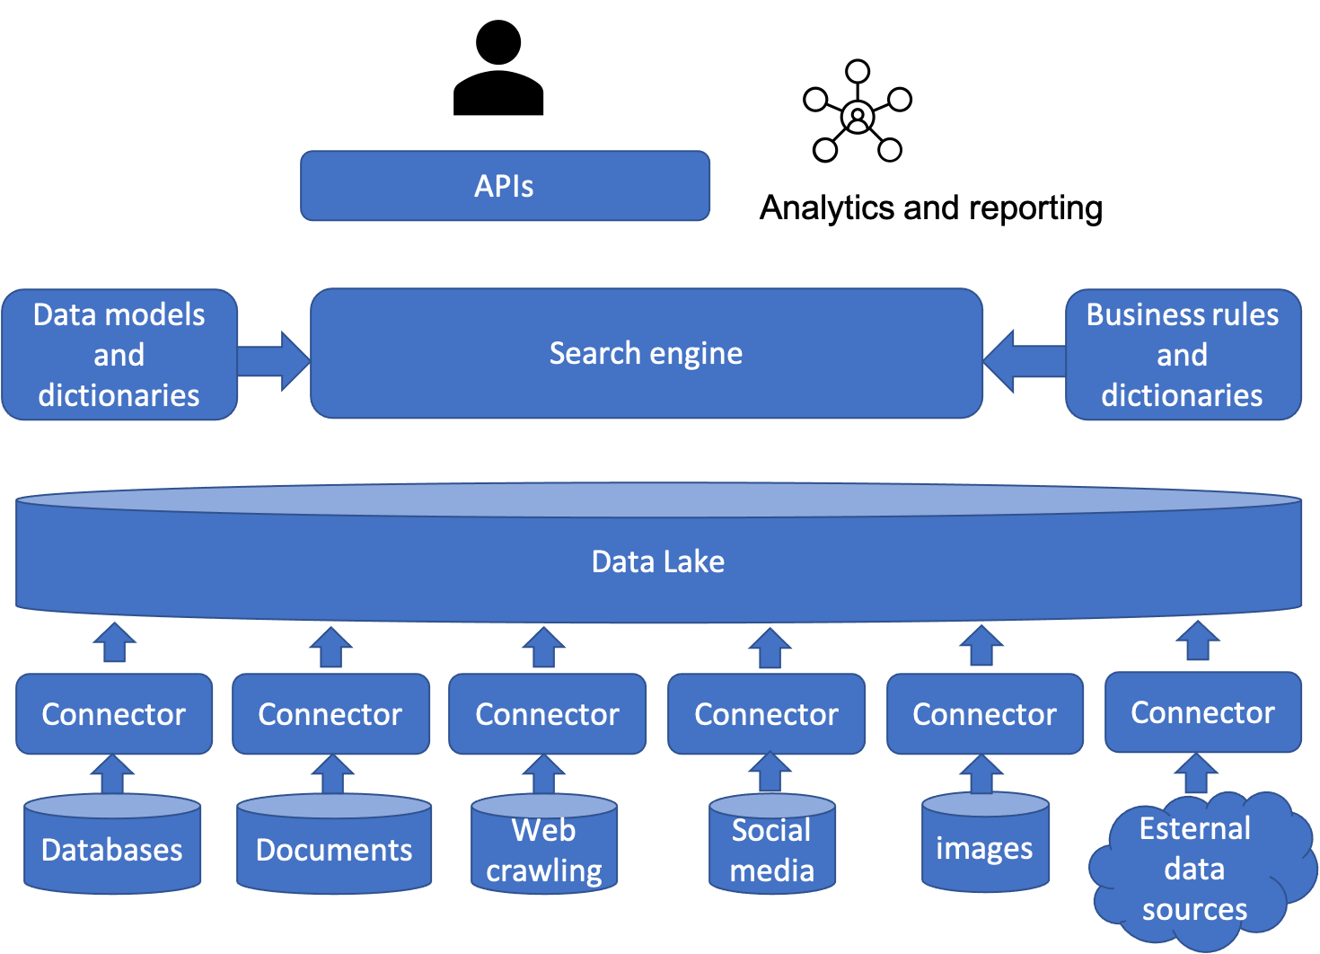
Conceptual Architecture

Slide 17
Outline
Data warehouse
Data warehouse modeling: schema and measures
Data cube: a multidimensional data model
Schemas for multidimensional data models: stars, snowflakes, and fact constellations
Concept hierarchies
Measures: categorization and computation
OLAP operations
Data cube computation
Data cube computation methods

Slide 18
From Tables and Spreadsheets to Data Cubes
A data warehouse is based on a multidimensional data model which views data in the form of a data cube
A data cube, such as sales, allows data to be modeled and viewed in multiple dimensions
Dimension tables, such as item (item_name, brand, type), or time(day, week, month, quarter, year)
Fact table contains measures (such as dollars_sold) and keys to each of the related dimension tables
Data cube: A lattice of cuboids
In data warehousing literature, an n-D base cube is called a base cuboid
The top most 0-D cuboid, which holds the highest-level of summarization, is called the apex cuboid
The lattice of cuboids forms a data cube.

Slide 19
Data Cube: A Lattice of Cuboids
all
0-D (apex) cuboid
time
item
location
supplier
1-D cuboids
time,location
item,location
location,supplier
time,item
2-D cuboids
time,supplier
item,supplier
time,location,supplier
3-D cuboids
time,item,location
time,item,supplier
item,location,supplier
4-D (base) cuboid
time, item, location, supplier

Slide 20
Conceptual Modeling of Data Warehouses
Modeling data warehouses: dimensions & measures
Star schema: A fact table in the middle connected to a set of dimension tables
Snowflake schema: A refinement of star schema where some dimensional hierarchy is normalized into a set of smaller dimension tables, forming a shape similar to snowflake
Fact constellations: Multiple fact tables share dimension tables, viewed as a collection of stars, therefore called galaxy schema or fact constellation

Slide 21
Star Schema: An Example
time
time_key
day
day_of_the_week
month
quarter
year
item
item_key
item_name
brand
type
supplier_type
Sales Fact Table
time_key
item_key
branch_key
branch
location
location_key
branch_key
branch_name
branch_type
location_key
street
city
state_or_province
country
units_sold
dollars_sold
avg_sales
Measures

Slide 22
Snowflake Schema: An Example
time
time_key
day
day_of_the_week
month
quarter
year
item
item_key
item_name
brand
type
supplier_key
supplier
Sales Fact Table
supplier_key
supplier_type
time_key
item_key
branch_key
location
branch
location_key
location_key
street
city_key
branch_key
branch_name
branch_type
units_sold
dollars_sold
city
avg_sales
city_key
city
state_or_province
country
Measures

Slide 23
Fact Constellation: An Example
time
time_key
day
day_of_the_week
month
quarter
year
item
Shipping Fact Table
item_key
item_name
brand
type
supplier_type
time_key
Sales Fact Table
time_key
item_key
item_key
shipper_key
branch_key
from_location
branch
location_key
to_location
location
branch_key
branch_name
branch_type
units_sold
location_key
street
city
province_or_state
country
dollars_cost
dollars_sold
units_shipped
avg_sales
shipper
Measures
shipper_key
shipper_name
location_key
shipper_type

Slide 24
A Concept Hierarchy for a Dimension (location)
all
all
region
Europe
...
North_America
country
Germany
...
Spain
Canada
...
Mexico
city
Frankfurt
...
Vancouver
...
Toronto
office
L. Chan
...
M. Wind

Slide 25
Data Cube Measures: Three Categories
Distributive: if the result derived by applying the function to n aggregate values is the same as that derived by applying the function on all the data without partitioning
E.g., count(), sum(), min(), max()
Algebraic: if it can be computed by an algebraic function with M arguments (where M is a bounded integer), each of which is obtained by applying a distributive aggregate function
avg(x) = sum(x) / count(x)
Is min_N() an algebraic measure? How about standard_deviation()?
Holistic: if there is no constant bound on the storage size needed to describe a subaggregate.
E.g., median(), mode(), rank()

Slide 26
Multidimensional Data
Sales volume as a function of product, month, and region
Dimensions: Product, Location, Time
Hierarchical summarization paths
Region
Industry Region Year
Category Country Quarter
Product City Month Week
Office Day
Product
Month

Slide 27
A Sample Data Cube
Date
Total annual sales
of TVs in U.S.A.
1Qtr
2Qtr
3Qtr
4Qtr
sum
Product
TV
PC
U.S.A
VCR
sum
Canada
Country
Mexico
sum
All, All, All

Slide 28
Cuboids Corresponding to the Cube
all
0-D (apex) cuboid
product
date
country
1-D cuboids
product,date
product,country
date, country
2-D cuboids
3-D (base) cuboid
product, date, country

Slide 29
Outline
Data warehouse
Data warehouse modeling: schema and measures
OLAP operations
Typical OLAP operations
Indexing OLAP data: bitmap index and join index
Storage implementation: column-based databases
Data cube computation
Data cube computation methods

Slide 30
Online Analytic Processing (OLAP)
Conceptually, we may explore all possible subspaces for interesting patterns
Some fundamental problems in analytics and data mining
What patterns are interesting?
How can we explore all possible subspaces systematically and efficiently?
Aggregates and group-bys are frequently used in data analysis and summarization
SELECT time, altitude, AVG(temp)
FROM weather GOUP BY time, altitude;
Online analytical processing (OLAP): the techniques that answer multi-dimensional analytical (MDA) queries efficiently

Slide 31
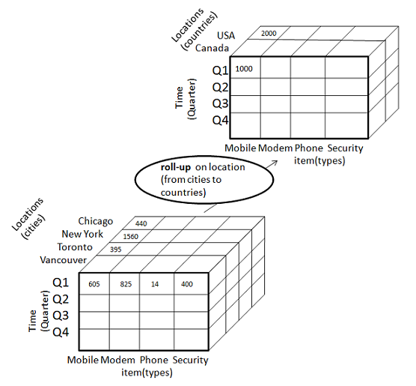
OLAP Operations
Roll up (drill-up): summarize data by climbing up hierarchy or by dimension reduction
(Day, Store, Product type, SUM(sales) → (Month, City, *, SUM(sales))
Drill down (roll down): reverse of roll-up, from higher level summary to lower level summary or detailed data, or introducing new dimensions
http://www.tutorialspoint.com/dwh/images/rollup.jpg

Slide 32
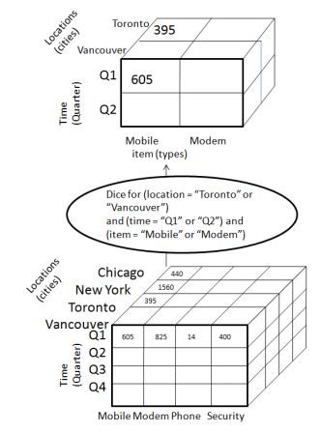
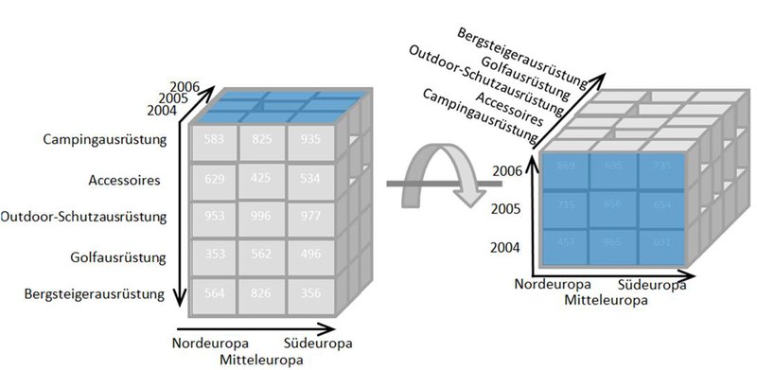
Other Operations
Dice: pick specific values or ranges on some dimensions
Pivot: “rotate” a cube – changing the order of dimensions in visual analysis
http://en.wikipedia.org/wiki/File:OLAP_pivoting.png
http://www.tutorialspoint.com/dwh/images/dice.jpg

Slide 33
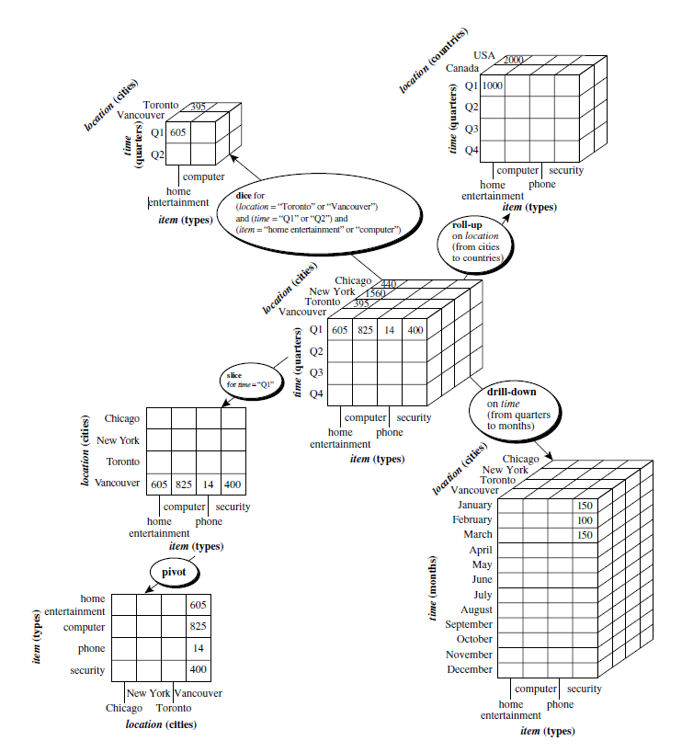
Typical OLAP Operations

Slide 34
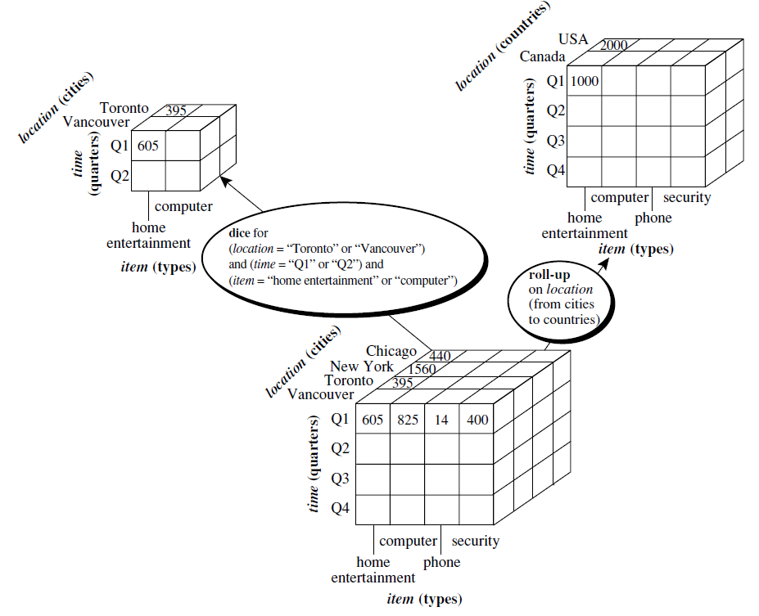

Slide 35
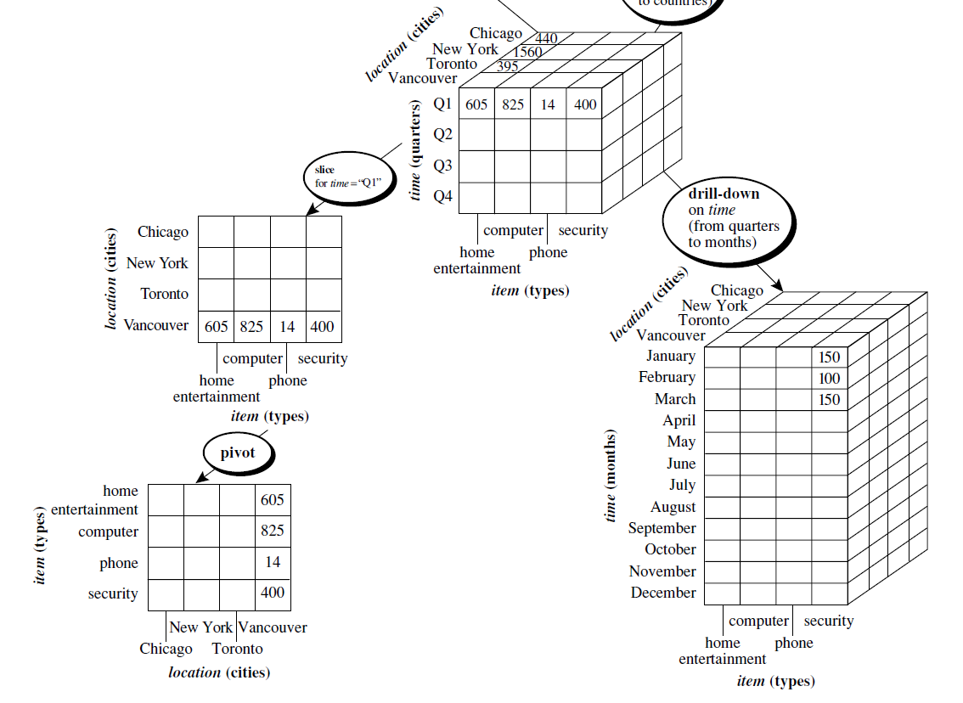

Slide 36
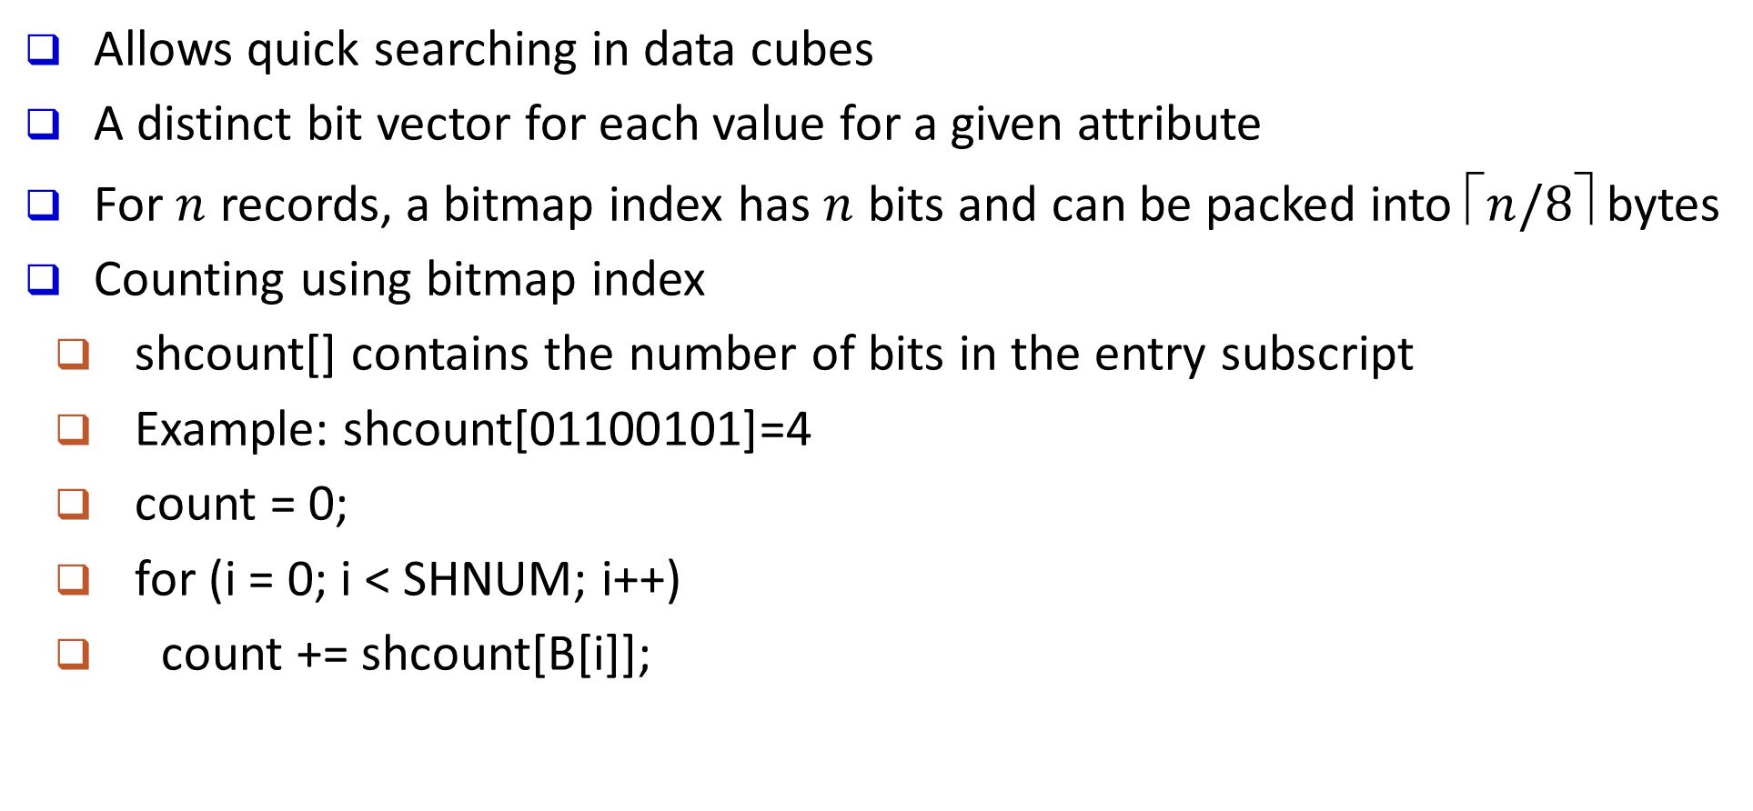
Bitmap Index
Allows quick searching in data cubes
A distinct bit vector for each value for a given attribute
For $n$ records, a bitmap index has $n$ bits and can be packed into $⬆n/8$ bytes
Counting using bitmap index
shcount[] contains the number of bits in the entry subscript
Example: shcount[01100101]=4
count = 0;
for (i = 0; i < SHNUM; i++)
count += shcount[B[i]];
age | succeed | …
45 | 1 | …
37 | 0 | …
… | … | …
52 | 1 | …
1 | 0 | … | 0

Slide 37
Indexing OLAP Data Using Bitmap Indices

Slide 38
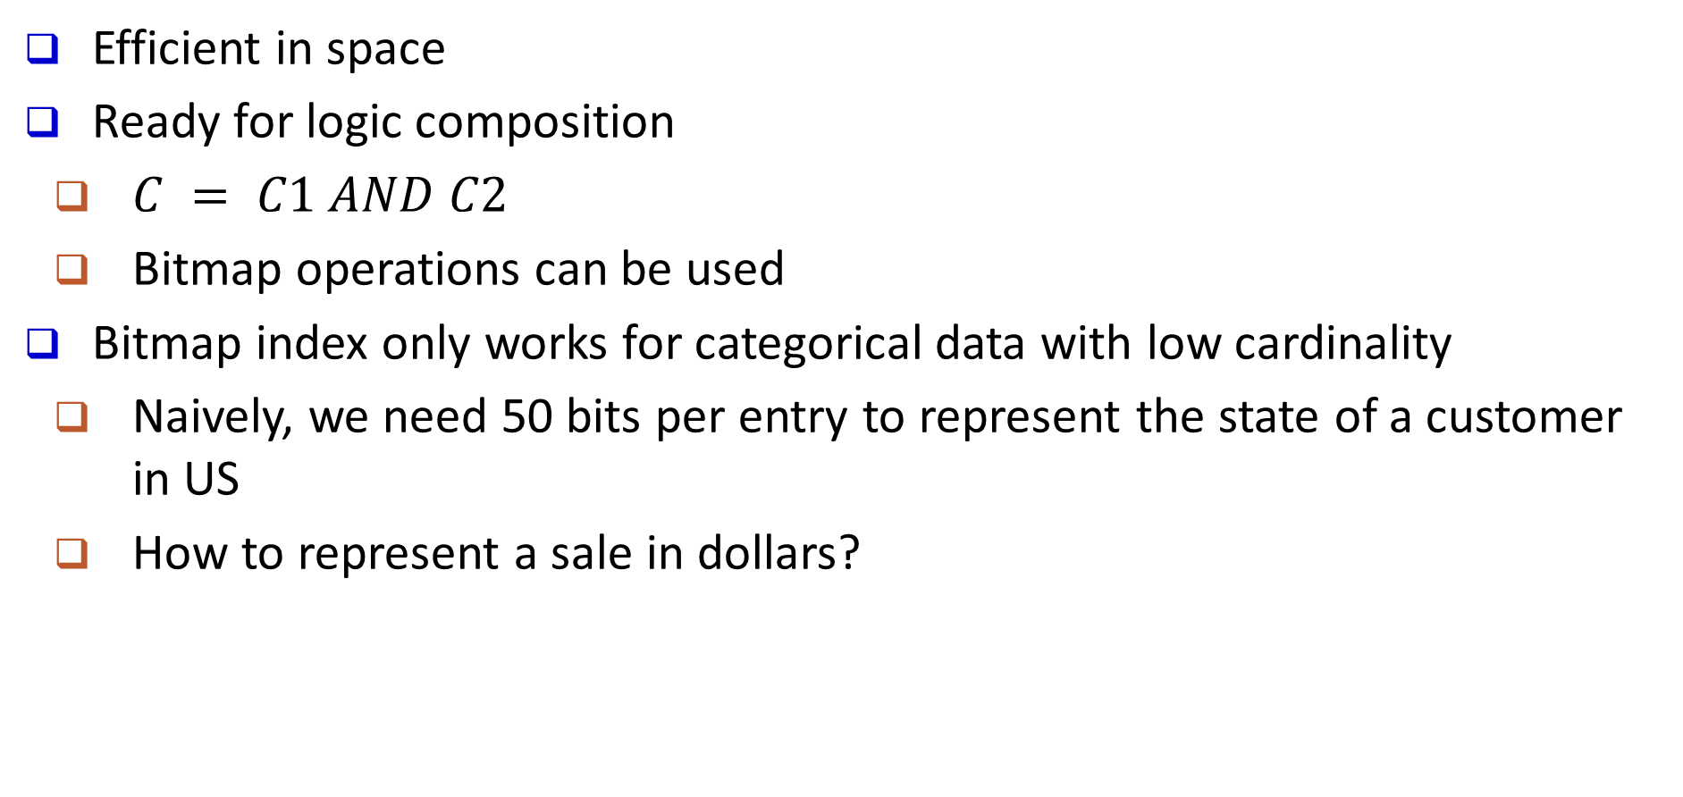
Advantages of Bitmap Index
Efficient in space
Ready for logic composition
$C = C1 AND C2$
Bitmap operations can be used
Bitmap index only works for categorical data with low cardinality
Naively, we need 50 bits per entry to represent the state of a customer in US
How to represent a sale in dollars?

Slide 39
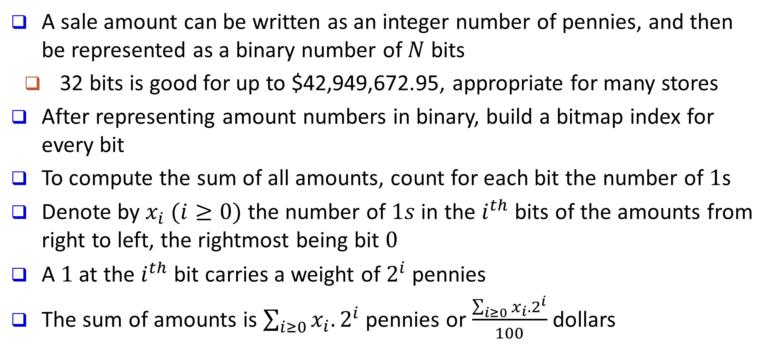
Bit-Sliced Index
A sale amount can be written as an integer number of pennies, and then be represented as a binary number of $N$ bits
32 bits is good for up to $42,949,672.95, appropriate for many stores
After representing amount numbers in binary, build a bitmap index for every bit
To compute the sum of all amounts, count for each bit the number of $1$s
Denote by $x_{i} (i≥0)$ the number of $1s$ in the $i^{th}$ bits of the amounts from right to left, the rightmost being bit $0$
A $1$ at the $i^{th}$ bit carries a weight of $2^{i}$ pennies
The sum of amounts is $\sum_{i≥0}{x_{i}.2^{i}}$pennies or $\frac{\sum_{i≥0}{x_{i}.2^{i}}}{100}$ dollars

Slide 40
Indexing OLAP Data Using Bit-sliced Indices

Slide 41
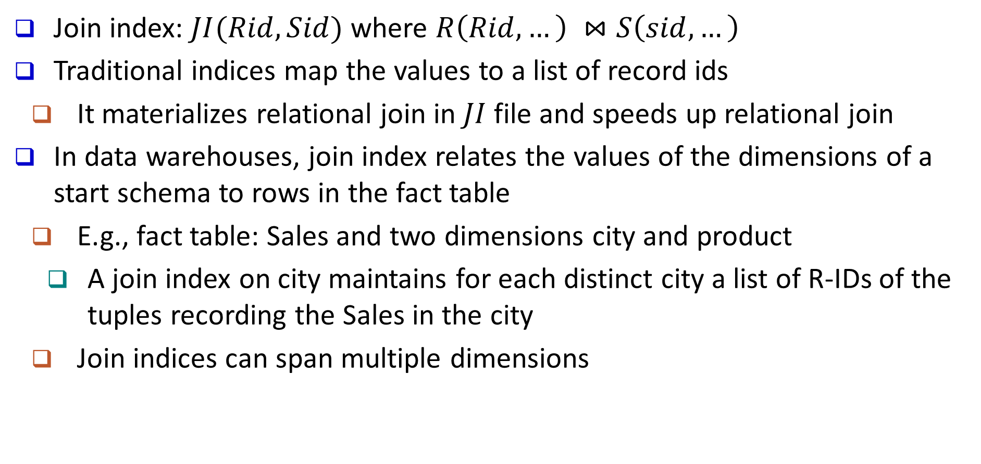
Indexing OLAP Data: Join Indices
Join index: $JI(Rid, Sid)$ where $R\left(Rid, …\right) ⋈S\left(sid, …\right)$
Traditional indices map the values to a list of record ids
It materializes relational join in $JI$ file and speeds up relational join
In data warehouses, join index relates the values of the dimensions of a start schema to rows in the fact table
E.g., fact table: Sales and two dimensions city and product
A join index on city maintains for each distinct city a list of R-IDs of the tuples recording the Sales in the city
Join indices can span multiple dimensions

Slide 42
Join Index Example

Slide 43
Horizontal versus Vertical Storage
A fact table for data warehousing is often fat
Tens of even hundreds of dimensions/attributes
A query is often about only a few attributes
Horizontal storage: tuples are stored one by one
Vertical storage: tuples are stored by attributes
A₁ | A₂ | … | A₁₀₀
x₁ | x₂ | … | x₁₀₀
… | … | … | …
z₁ | z₂ | … | z₁₀₀
A₁ | A₂ | … | A₁₀₀
x₁ | x₂ | … | x₁₀₀
… | … | … | …
z₁ | z₂ | … | z₁₀₀

Slide 44
Column-based Storage

Slide 45
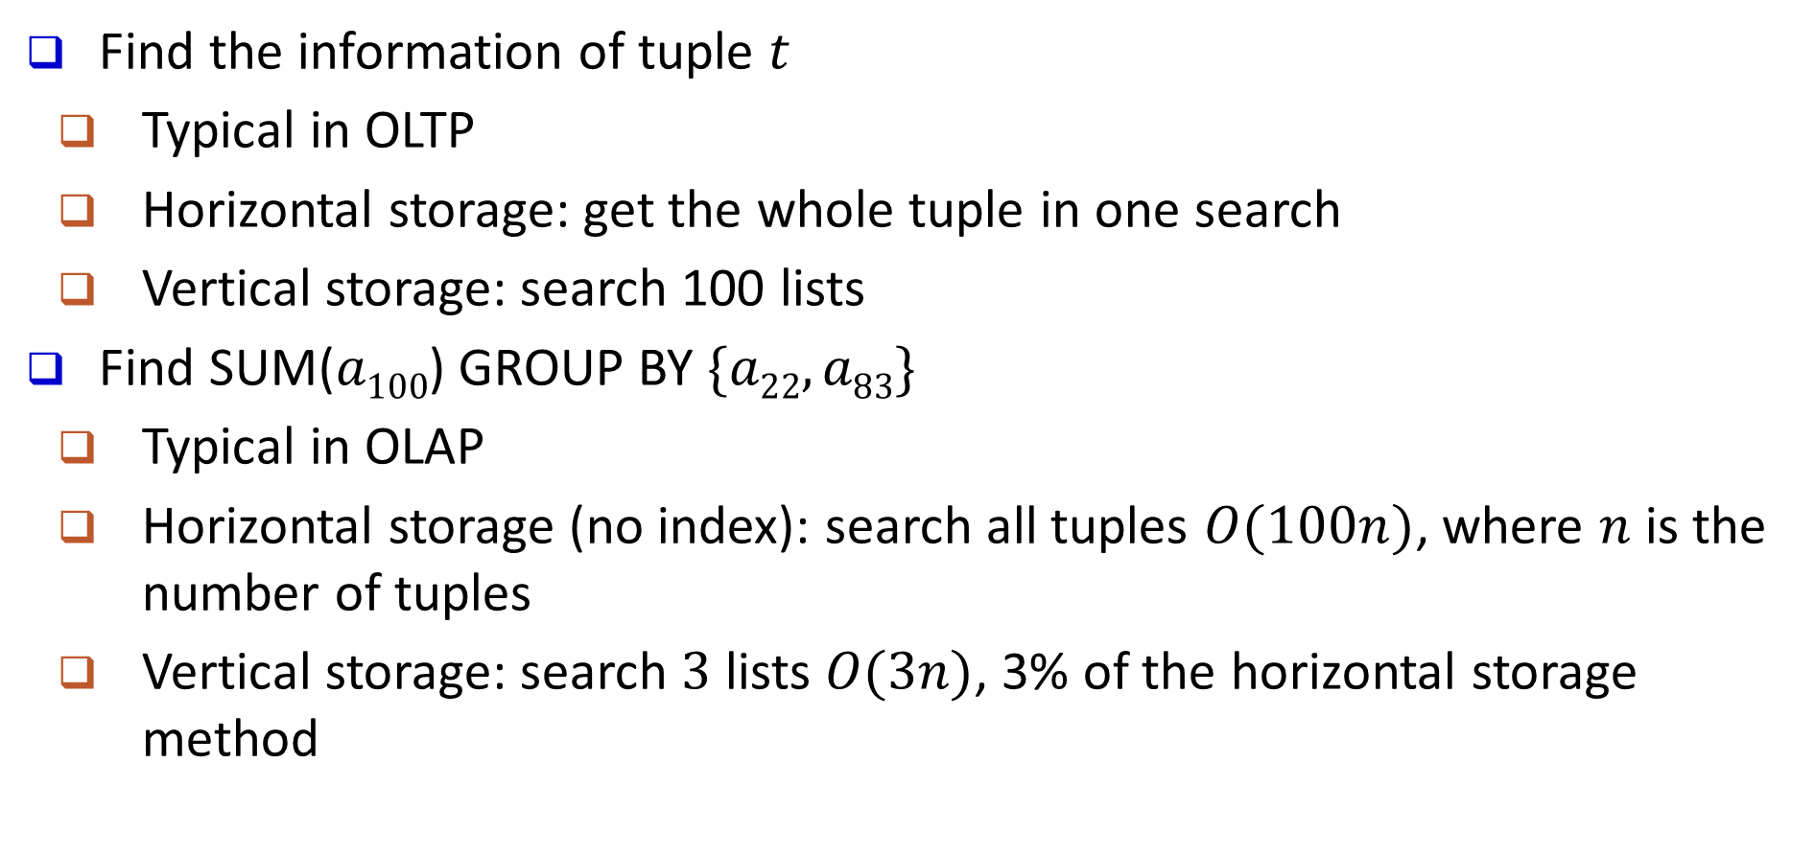
Query Answering Using Vertical Storage
Find the information of tuple $t$
Typical in OLTP
Horizontal storage: get the whole tuple in one search
Vertical storage: search 100 lists
Find SUM($a100$) GROUP BY $\{a22, a83\}$
Typical in OLAP
Horizontal storage (no index): search all tuples $O(100n)$, where $n$ is the number of tuples
Vertical storage: search $3$ lists $O(3n)$, 3% of the horizontal storage method

Slide 46
Outline
Data warehouse
Data warehouse modeling: schema and measures
OLAP operations
Data cube computation
Terminology of data cube computation
Data cube materialization: ideas
OLAP server architectures: ROLAP vs. MOLAP vs. HOLAP
General strategies for data cube computation
Data cube computation methods

Slide 47
Data Cube: A Lattice of Cuboids
all
0-D(apex) cuboid
time
item
location
supplier
1-D cuboids
time,location
item,location
location,supplier
2-D cuboids
time,item
time,supplier
item,supplier
time,location,supplier
3-D cuboids
time,item,location
time,item,supplier
item,location,supplier
4-D(base) cuboid
time, item, location, supplierc

Slide 48
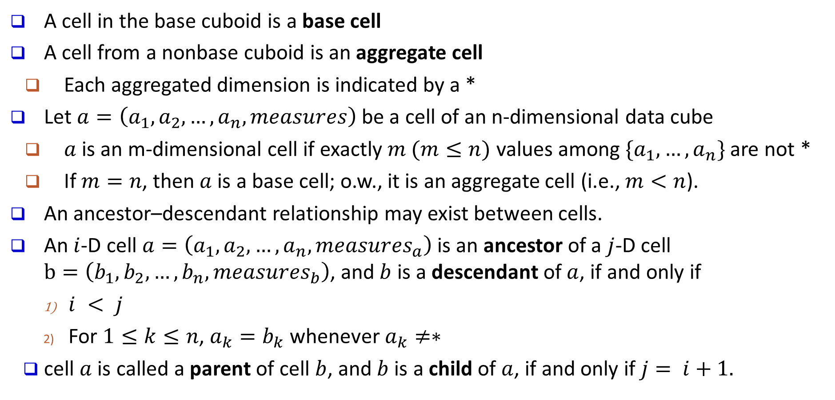
Data Cube: A Lattice of Cuboids
A cell in the base cuboid is a base cell
A cell from a nonbase cuboid is an aggregate cell
Each aggregated dimension is indicated by a *
Let $a=\left(a_{1}, a_{2}, …, a_{n}, measures\right)$ be a cell of an n-dimensional data cube
$a$ is an m-dimensional cell if exactly $m (m≤n)$ values among $\{a_{1},…,a_{n}\}$ are not *
If $m=n$, then $a$ is a base cell; o.w., it is an aggregate cell (i.e., $m<n$).
An ancestor–descendant relationship may exist between cells.
An $i$-D cell $a=\left(a_{1}, a_{2}, …, a_{n}, measures_{a}\right)$ is an ancestor of a $j$-D cell $b=\left(b_{1}, b_{2}, …, b_{n}, measures_{b}\right)$, and $b$ is a descendant of $a$, if and only if
$i < j$
For $1≤k≤n$, $a_{k}=b_{k}$ whenever $a_{k}≠∗$
cell $a$ is called a parent of cell $b$, and $b$ is a child of $a$, if and only if $j= i+1.$

Slide 49
Data Cube: A Lattice of Cuboids
all
0-D(apex) cuboid
(*,*,*)
(*, milk, *, *)
(*, milk, Urbana, *)
(*, milk, Chicago, *)
(9/15, milk, Urbana, *)
(9/15, milk, Urbana, Dairy_land)
time
item
location
supplier
1-D cuboids
time,item
time,location
item,location
location,supplier
item,supplier
2-D cuboids
time,supplier
time,location,supplier
3-D cuboids
time,item,location
item,location,supplier
time,item,supplier
time, item, location, supplier
4-D(base) cuboid

Slide 50
OLAP Server Architectures
Relational OLAP (ROLAP)
Use relational or extended-relational DBMS to store and manage warehouse data and OLAP middle ware
Include optimization of DBMS backend, implementation of aggregation navigation logic, and additional tools and services
Greater scalability
Multidimensional OLAP (MOLAP)
Sparse array-based multidimensional storage engine
Fast indexing to pre-computed summarized data
Hybrid OLAP (HOLAP) (e.g., Microsoft SQLServer)
Flexibility, e.g., low level: relational, high-level: array
Specialized SQL servers (e.g., Redbricks)
Specialized support for SQL queries over star/snowflake schemas

Slide 51

Cube Materialization: Full Cube vs. Iceberg Cube
Full cube vs. iceberg cube
compute cube sales iceberg as
select month, city, customer group, count(*)
from salesInfo
cube by month, city, customer group
having count(*) >= min support
Compute only the cells whose measure satisfies the iceberg condition
Only a small portion of cells may be “above the water’’ in a sparse cube
Ex.: Show only those cells whose count is no less than 100
iceberg condition
Notes:
51

Slide 52
Why Iceberg Cube?
Advantages of computing iceberg cubes
No need to save nor show those cells whose value is below the threshold (iceberg condition)
Efficient methods may even avoid computing the un-needed, intermediate cells
Avoid explosive growth
Example: a cube with 100 dimensions
Suppose it contains only 2 base cells: {(a₁, a₂, a₃, …., a₁₀₀), (a₁, a₂, b₃, …, b₁₀₀)}
How many aggregate cells if “having count >= 1”?
Answer: (2¹⁰¹ ─ 2) ─ 4 (Why?!)
What about the iceberg cells, (i,e., with condition: “having count >= 2”)?
Answer: 4 (Why?!)

Slide 53
Example
Sales(year, city, cust_grp, prod_grp, count)
dimensional attributes
measure attribute
Base cuboid:
c1 | (2000, Vancouver, Business, PC, 300)
c2 | (2000, Vancouver, Student, Camera, 100)
Iceberg condition: having count ≥ 100
Cells in the Iceberg Cube:
(*, Van., Bus., PC, 300) | (2000, *, *, PC, 300) | (2000, Van., Stu., *, 100) | (*, *, *, Cam., 100)
(2000, *, Bus., PC, 300) | (2000, *, Bus., *, 300) | (*, *, Stu., Cam., 100) | (2000, Van., *, *, 400)
(2000, Van., *, PC, 300) | (*, *, Bus., *, 300) | (*, Van., *, Cam., 100) | (2000, *, *, *, 400)
(2000, Van., Bus., *, 300) | (*, *, *, PC, 300) | (*, Van., Stu., *, 100) | (*, Van., *, *, 400)
(*, *, Bus., PC, 300) | (*, Van., Stu., Cam., 100) | (2000, *, *, Cam., 100) | (*, *, *, *, 400)
(*, Van., *, PC, 300) | (2000, *, Stu., Cam., 100) | (2000, *, Stu., *, 100)
(*, Van., Bus., *, 300) | (2000, Van., *, Cam., 100) | (*, *, Stu., *, 100)
Total number of Cells in the Iceberg cube:
2 * 2⁴ – 4 = 28

Slide 54
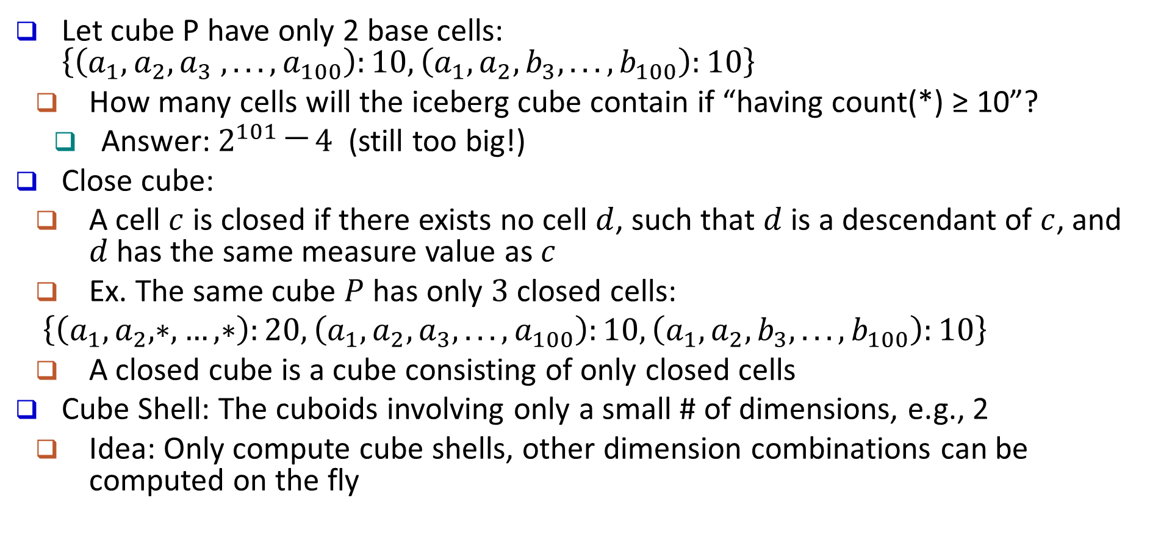
Is Iceberg Cube Good Enough? Closed Cube & Cube Shell
Let cube P have only 2 base cells: $\left\{\left(a_{1}, a_{2}, a_{3} ,. . . , a_{100}\right):10, \left(a_{1}, a_{2}, b_{3}, . . . , b_{100}\right):10\right\}$
How many cells will the iceberg cube contain if “having count(*) ≥ 10”?
Answer: $2^{101} ─ 4$ (still too big!)
Close cube:
A cell $c$ is closed if there exists no cell $d$, such that $d$ is a descendant of $c$, and $d$ has the same measure value as $c$
Ex. The same cube $P$ has only $3$ closed cells:
$\left\{\left(a_{1}, a_{2}, ∗, …, ∗\right):20, \left(a_{1}, a_{2}, a_{3}, . . . , a_{100}\right):10, \left(a_{1}, a_{2}, b_{3}, . . . , b_{100}\right):10\right\}$
A closed cube is a cube consisting of only closed cells
Cube Shell: The cuboids involving only a small # of dimensions, e.g., 2
Idea: Only compute cube shells, other dimension combinations can be computed on the fly
Q: For (A₁, A₂, … A₁₀₀), how many combinations to compute?

Slide 55
Example
Sales(year, city, cust_grp, prod_grp, count)
Closed Cells
dimensional attributes
measure attribute
Base cuboid:
c1 | (2000, Vancouver, Business, PC, 300)
c2 | (2000, Vancouver, Student, Camera, 100)
Iceberg condition: having count ≥ 100
Cells in the Iceberg Cube:
(*, Van., Bus., PC, 300) | (2000, *, *, PC, 300) | (2000, Van., Stu., *, 100) | (*, *, *, Cam., 100)
(2000, *, Bus., PC, 300) | (2000, *, Bus., *, 300) | (*, *, Stu., Cam., 100) | (2000, Van., *, *, 400)
(2000, Van., *, PC, 300) | (*, *, Bus., *, 300) | (*, Van., *, Cam., 100) | (2000, *, *, *, 400)
(2000, Van., Bus., *, 300) | (*, *, *, PC, 300) | (*, Van., Stu., *, 100) | (*, Van., *, *, 400)
(*, *, Bus., PC, 300) | (*, Van., Stu., Cam., 100) | (2000, *, *, Cam., 100) | (*, *, *, *, 400)
(*, Van., *, PC, 300) | (2000, *, Stu., Cam., 100) | (2000, *, Stu., *, 100)
(*, Van., Bus., *, 300) | (2000, Van., *, Cam., 100) | (*, *, Stu., *, 100)
Total number of Cells in the Iceberg cube:
2 * 2⁴ – 4 = 28

Slide 56
Roadmap for Efficient Computation
General computation heuristics (Agarwal et al.’96)
Computing full/iceberg cubes: 3 methodologies
Bottom-Up: Multi-Way array aggregation (Zhao, Deshpande & Naughton, SIGMOD’97)
Top-down: BUC (Beyer & Ramarkrishnan, SIGMOD’99)
Integrating Top-Down and Bottom-Up: Star-cubing algorithm (Xin, Han, Li & Wah: VLDB’03)
High-dimensional OLAP:
A Shell-Fragment Approach (Li, et al. VLDB’04)
Computing alternative kinds of cubes:
Partial cube, closed cube, approximate cube, ……

Slide 57
Outline
Data warehouse
Data warehouse modeling: schema and measures
OLAP operations
Data cube computation
Data cube computation methods
Multiway array aggregation for full cube computation
BUC: computing iceberg cubes from the apex cuboid downward
Precomputing shell fragments for fast high-dimensional OLAP

Slide 58
Multi-Way Array Aggregation
Array-based “bottom-up” algorithm (from ABC to AB,…)
Using multi-dimensional chunks
Simultaneous aggregation on multiple dimensions
Intermediate aggregate values are re-used for computing ancestor cuboids
Cannot do Apriori pruning: No iceberg optimization
Pros and cons
Efficient for computing the full cube for a small number of dimensions
If there are a large number of dimensions, “top-down” computation and iceberg cube computation methods (e.g., BUC) should be used

Slide 59
Cube Computation: Multi-Way Array Aggregation (MOLAP)
Partition arrays into chunks (a small subcube which fits in memory).
Compressed sparse array addressing: (chunk_id, offset)
Compute aggregates in “multiway” by visiting cube cells in the order which minimizes the # of times to visit each cell, and reduces memory access and storage cost
C
c3
61
62
63
64
c2
45
46
47
48
c1
29
30
31
32
c 0
B
60
b3
13
14
15
16
44
9
28
56
b2
What is the best traversing order to do multi-way aggregation?
B
40
5
24
52
b1
36
20
b0
1
2
3
4
a0
a1
a2
a3
A

Slide 60
Multi-Way Array Aggregation (3-D to 2-D)
How to minimizes the memory requirement and reduced I/Os?
AB
BC
Entire AB plane
A: 40, B: 400, C: 4000
Keep the smallest plane in main memory, fetch and compute only one chunk at a time for the largest plane
The planes should be sorted and computed according to their size in ascending order
One chunk of BC plane
AC
One column of AC plane

Slide 61
Multi-Way Array Aggregation (2-D to 1-D)
Same methodology for computing 2-D and 1-D planes

Slide 62
Cube Computation: Computing in Reverse Order
BUC (Beyer & Ramakrishnan, SIGMOD’99)
BUC: acronym of Bottom-Up (cube) Computation
(Note: It is “top-down” in our view since we put Apex cuboid on the top!)
Divides dimensions into partitions and facilitates iceberg pruning
If a partition does not satisfy min_sup, its descendants can be pruned
If minsup = 1 ⇒ compute full CUBE!
No simultaneous aggregation

Slide 63
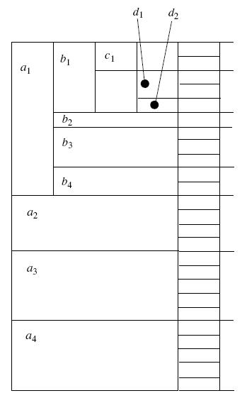
BUC: Partitioning and Aggregating
Starting from a single dimension groupby
If current inputs can be pruned return
Partition the data in this group-by
If a partition is greater than the minsup
recursive call on BUC with the partition as inputs
Loop until all dimensions are done
min_supp = 3

Slide 64
Example
A | B | C | D
a1 | b1 | c3 | d1
a1 | b5 | c1 | d2
a1 | b2 | c5 | d2
a2 | b2 | c2 | d2
a2 | b2 | c2 | d4
a2 | b2 | c4 | d2
a2 | b3 | c2 | d3
a3 | b4 | c6 | d2
(a1, *, *, *):3 → A
(a2, *, *, *):4 → A
(a1, *, *, d2):2 → AD
(a2, b2, *, *): 3 → AB
(a2, b2, c2, *): 2 → ABC
…
min_supp = 2

Slide 65
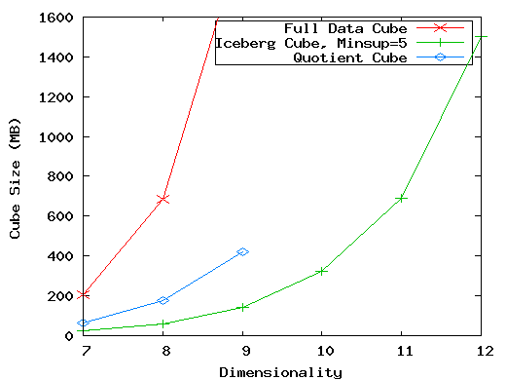
High-Dimensional OLAP?— The Curse of Dimensionality
High-D OLAP: Needed in many applications
Science and engineering analysis
Bio-data analysis: thousands of genes
Statistical surveys: hundreds of variables
A curse of dimensionality: A database of 600k tuples. Each dimension has cardinality of 100 and zipf of 2
None of the previous cubing method can handle high dimensionality!
Iceberg cube and compressed cubes: only delay the inevitable explosion
Full materialization: still significant overhead in accessing results on disk
A shell-fragment approach: X. Li, J. Han, and H. Gonzalez, High-Dimensional OLAP: A Minimal Cubing Approach, VLDB'04

Slide 66
Fast High-D OLAP with Minimal Cubing
Observation: OLAP occurs only on a small subset of dimensions at a time
Semi-Online Computational Model
Partition the set of dimensions into shell fragments
Compute data cubes for each shell fragment while retaining inverted indices or value-list indices
Given the pre-computed fragment cubes, dynamically compute cube cells of the high-dimensional data cube online
Major idea: Tradeoff between the amount of pre-computation and the speed of online computation
Reducing computing high-dimensional cube into precomputing a set of lower dimensional cubes
Online re-construction of original high-dimensional space
Lossless reduction

Slide 67
Computing a 5-D Cube with 2-Shell Fragments
Example: Let the cube aggregation function be count
Divide the 5-D table into 2 shell fragments:
(A, B, C) and (D, E)
Build traditional invert index or RID list
Attribute Value | TID List | List Size
a1 | 1 2 3 | 3
a2 | 4 5 | 2
b1 | 1 4 5 | 3
b2 | 2 3 | 2
c1 | 1 2 3 4 5 | 5
d1 | 1 3 4 5 | 4
d2 | 2 | 1
e1 | 1 2 | 2
e2 | 3 4 | 2
e3 | 5 | 1
tid | A | B | C | D | E
1 | a1 | b1 | c1 | d1 | e1
2 | a1 | b2 | c1 | d2 | e1
3 | a1 | b2 | c1 | d1 | e2
4 | a2 | b1 | c1 | d1 | e2
5 | a2 | b1 | c1 | d1 | e3

Slide 68
Shell Fragment Cubes: Ideas
Generalize the 1-D inverted indices to multi-dimensional ones in the data cube sense
Compute all cuboids for data cubes ABC and DE while retaining the inverted indices
Ex. shell fragment cube ABC contains 7 cuboids:
A, B, C; AB, AC, BC; ABC
This completes the offline computation

Slide 69
Shell Fragment Cubes: Example of Ideas
ID_Measure Table
If measures other than count are present, store in ID_measure table separate from the shell fragments
Attribute Value | TID List | List Size
a1 | 1 2 3 | 3
a2 | 4 5 | 2
b1 | 1 4 5 | 3
b2 | 2 3 | 2
c1 | 1 2 3 4 5 | 5
d1 | 1 3 4 5 | 4
d2 | 2 | 1
e1 | 1 2 | 2
e2 | 3 4 | 2
e3 | 5 | 1
Shell-fragment AB
tid | count | sum
1 | 5 | 70
2 | 3 | 10
3 | 8 | 20
4 | 5 | 40
5 | 2 | 30
Cell | Intersection | TID List | List Size
a1 b1 | 1 2 3 ∩ 1 4 5 | 1 | 1
a1 b2 | 1 2 3 ∩ 2 3 | 2 3 | 2
a2 b1 | 4 5 ∩ 1 4 5 | 4 5 | 2
a2 b2 | 4 5 ∩ 2 3 | φ | 0

Slide 70
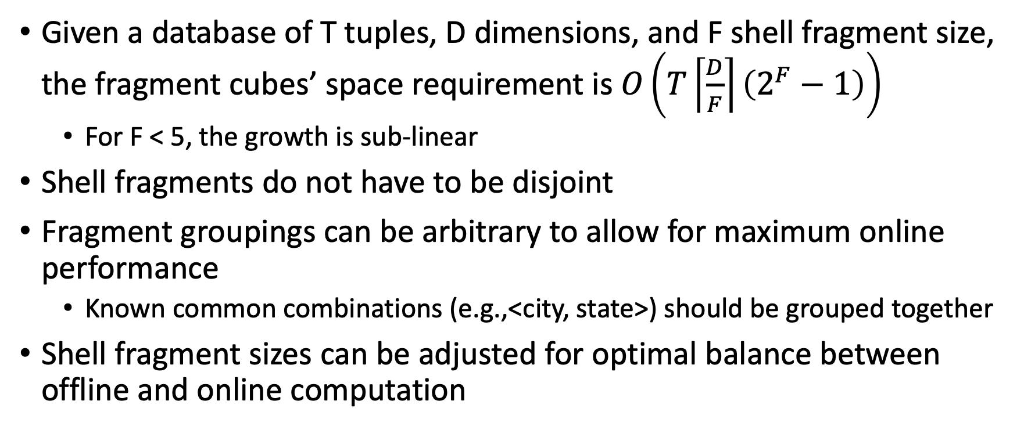
Shell Fragment Cubes: Size and Design
Given a database of T tuples, D dimensions, and F shell fragment size, the fragment cubes’ space requirement is $O\left(T\left\lceil \frac{D}{F}\right\rceil \left(2^{F}−1\right)\right)$
For F < 5, the growth is sub-linear
Shell fragments do not have to be disjoint
Fragment groupings can be arbitrary to allow for maximum online performance
Known common combinations (e.g.,<city, state>) should be grouped together
Shell fragment sizes can be adjusted for optimal balance between offline and online computation

Slide 71
Use Frag-Shells for Online OLAP Query Computation
Dimensions
A | B | C | D | E | F | …
A | B | C | D | E | F | G | H | I | J | K | L | M | N | …
ABC Cube
DEF Cube
D Cuboid
EF Cuboid
DE Cuboid
Instantiated
Base Table
Online
Cube
Cell | Tuple-ID List
d1 e1 | {1, 3, 8, 9}
d1 e2 | {2, 4, 6, 7}
d2 e1 | {5, 10}
… | …
Processing query in the form: <a₁, a₂, …, a_{n}: M>

Slide 72
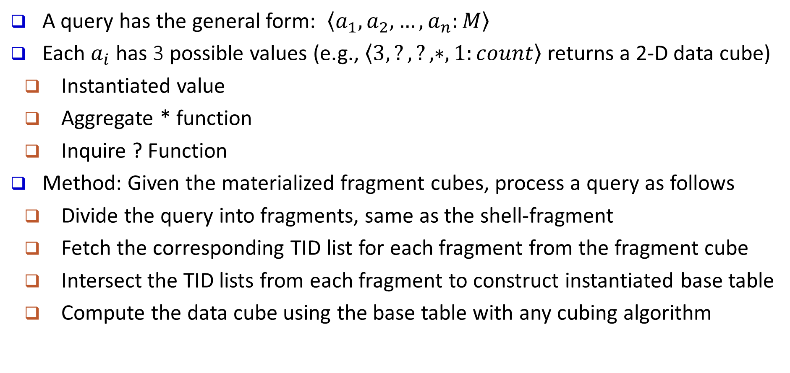
Online Query Computation with Shell-Fragments
A query has the general form: $\left\langle a_{1}, a_{2}, …, a_{n}:M\right\rangle$
Each $a_{i}$ has 3 possible values (e.g., $\left\langle 3,?,?,∗,1:count\right\rangle$ returns a 2-D data cube)
Instantiated value
Aggregate * function
Inquire ? Function
Method: Given the materialized fragment cubes, process a query as follows
Divide the query into fragments, same as the shell-fragment
Fetch the corresponding TID list for each fragment from the fragment cube
Intersect the TID lists from each fragment to construct instantiated base table
Compute the data cube using the base table with any cubing algorithm

Slide 73
Computing Cubes with Non-Antimonotonic Iceberg Conditions
The measure of an iceberg cube is antimonotonic if:
If the aggregate value on a shared dimension does not satisfy the iceberg condition, then all of the cells descending from this shared dimension cannot satisfy the iceberg condition either
Most cubing algorithms cannot compute cubes with non-antimonotonic iceberg conditions efficiently
Example
AVG(price) >= 800 AND COUNT(*) >= 50
Needs to study how to push constraint into the cubing process

Slide 74
Non-Anti-Monotonic Iceberg Condition
The cubing query with avg is non-anti-monotonic!
(Mar, *, *, Laptop, 600, 700) fails the HAVING clause
(Mar, *, Bus, Laptop, 300, 950) passes the clause
Month | City | Cust_grp | Prod | Count | Price
Jan | Tor | Edu | Printer | 500 | 485
Jan | Tor | Hld | TV | 800 | 1200
Jan | Tor | Edu | Camera | 1160 | 1280
Feb | Mon | Bus | Laptop | 1500 | 2500
Mar | Van | Edu | HD | 540 | 520
… | … | … | … | … | …
Dimensions:
month, city, cust_grp, prod,
count, AVG(price)
Condition:
AVG(price) >= 800 AND
COUNT(*) >= 50

Slide 75
From Average to Top-k Average
Let (*, Van, *) cover 1,000 records
Avg(price) is the average price of those 1000 sales
Avg⁵⁰(price) is the average price of the top-50 sales (top-50 according to the sales price(
Top-k average is anti-monotonic
The top 50 sales in Van. is with avg(price) <= 800 → the top 50 deals in Van. during Feb. must be with avg(price) <= 800
Month | City | Cust_grp | Prod | Cost | Price
… | … | … | … | … | …

Slide 76
Binning for Top-k Average
Computing top-k avg is costly with large k
Binning idea
Avg⁵⁰(c) >= 800
Large value collapsing: use a sum and a count to summarize records with measure >= 800
Small value binning: a group of bins
One bin covers a range, e.g., 600~800, 400~600, etc.
Register a sum and a count for each bin

Slide 77
Computing Approximate top-k average
Suppose for (*, Van, *), we have
Approximate avg⁵⁰()=
(28000+10600+600*15)/50=952
Range | Sum | Count
Over 800 | 28000 | 20
600~800 | 10600 | 15
400~600 | 15200 | 30
… | … | …
Top 50
The cell may pass the HAVING clause
Month | City | Cust_grp | Prod | Cost | Price
… | … | … | … | … | …

Slide 78
Weakened Conditions Facilitate Pushing
weakest
strongest
Approximate avg⁵⁰() Anti-monotonic, can be computed efficiently |  | real avg⁵⁰() Anti-monotonic, but computationally costly |  | avg() Not anti-monotonic

Slide 79
Summary
Data warehousing: A multi-dimensional model of a data warehouse
A data cube consists of dimensions & measures
Star schema, snowflake schema, fact constellations
OLAP operations: drilling, rolling, slicing, dicing and pivoting
Data Warehouse has a Multi-tiered Architecture
Implementation: Efficient computation of data cubes
Partial vs. full vs. no materialization
OLAP servers: ROLAP, MOLAP, HOLAP
Data Cube Computation Methods
MultiWay Array Aggregation
BUC
High-Dimensional OLAP with Shell-Fragments

